Slide 1
Creating Inclusive Cultures
Ways of working
Team workshop series
@RAEngNews | www.raeng.org.uk/teamworkshops

Slide 2
Ways of working
Leveraging different styles and ways of working can bring business benefits through: increased innovation and the creation of opportunities for new and diverse customer acquisition and wider market access; more engaged individuals; increased wellbeing; better communication; and higher productivity.
Introduction
What do we mean by different ways of working?
Questions to explore preferred ways of working
Work preference scales exercise
How can we acknowledge and maximise the value of these differences?
What is the one thing I am going to do differently?

Slide 3
Relationships
How people prefer to relate with others
Do you feel more energised from talking things through with others
or working on your own?
Talking things through with others
Working on your own
5 4 3 2 1 0 1 2 3 4 5

Slide 4
Information
How people prefer to gather and take in information
Do you find that you learn best by doing something or reading about it first?
Learn by doing first
Learn by reading about it first
5 4 3 2 1 0 1 2 3 4 5

Slide 5
Decisions
How people prefer to make decisions
When making decisions do you like to gather all the data and information
or use gut feel/instinct?
Gather data/information
Use gut feel/instinct
5 4 3 2 1 0 1 2 3 4 5

Slide 6
Organisation
How prefer to organise themselves and others
Do you prefer to follow a method and work in a structured way or are you more comfortable ‘feeling your way’ through a process and working in a flexible way?
Structured way
Flexible way
5 4 3 2 1 0 1 2 3 4 5

Slide 7
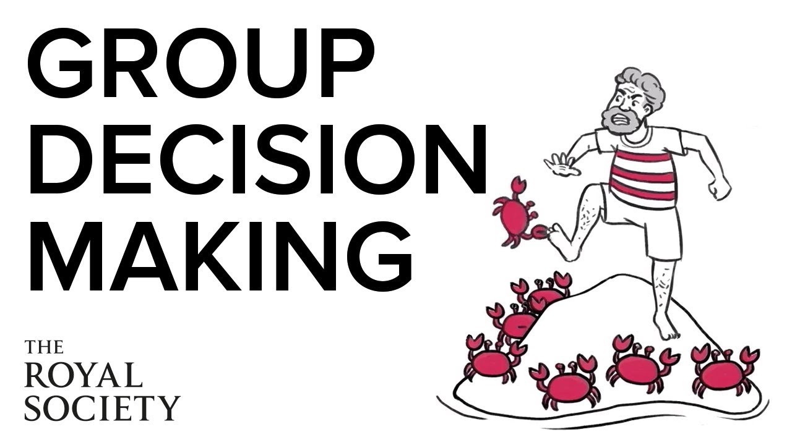
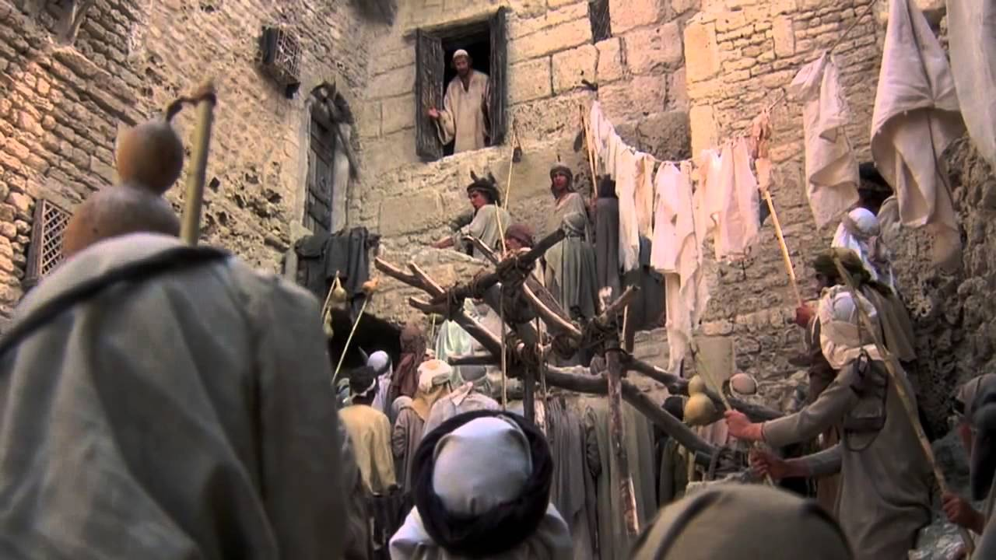
Video links

Slide 8
Thank you and feedback
Thank you for attending this workshop
Please fill in the brief online feedback survey for the Academy so that we may continue to learn and improve the sessions we run.

Slide 9
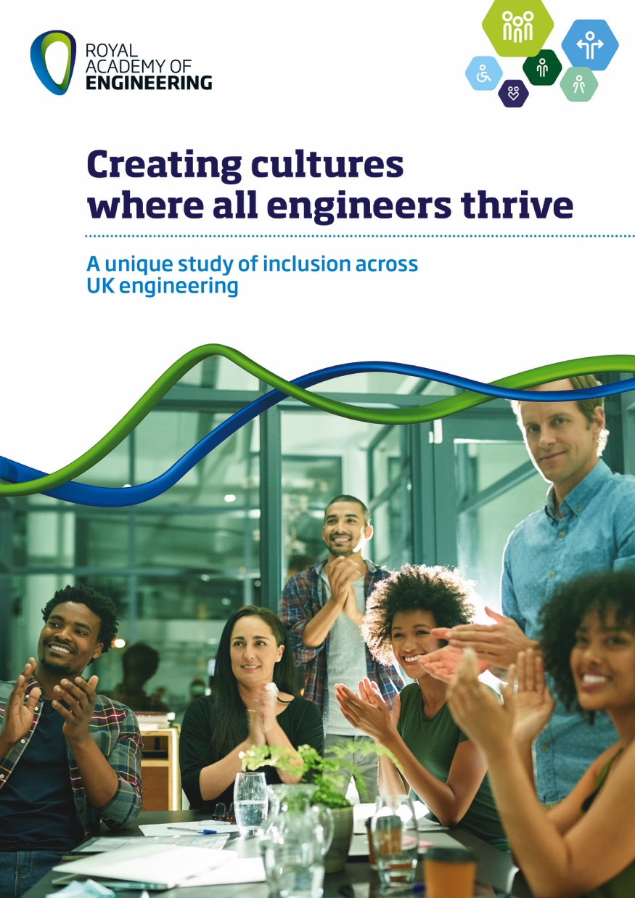
Want to know more?
Four workshops:
Why is diversity and inclusion important?
Language and banter
Ways of working
Problem-solving
www.raeng.org.uk/teamworkshops

Slide 10


About us
The Royal Academy of Engineering is harnessing the power of engineering to build a sustainable society and an inclusive economy that works for everyone.
In collaboration with our Fellows and partners, we’re growing talent and developing skills for the future, driving innovation and building global partnerships, and influencing policy and engaging the public.
Together we’re working to tackle the greatest challenges of our age.
Get in touch at:

