Slide 1
Creating Inclusive Cultures
Language and banter
Team workshop series
@RAEngNews | www.raeng.org.uk/teamworkshops

Slide 2
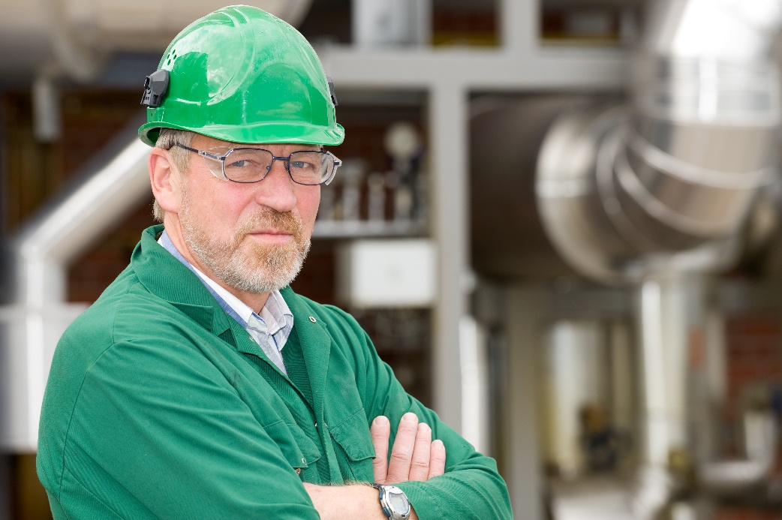
Bob
55-year-old man
Married 34 years with two adult children
Was in merchant navy for 20 years before he joined the organisation
Leads the workshop team
Lively member of the team – was the MC at the Christmas party

Slide 3
Bob
I was upset when I heard Fred talk about a ‘spaz’– my son has a severe disability but he is a human being and deserves respect
Bob sometimes has to leave work to deal with a medical emergency for his son
Bob’s colleague has Indian heritage
Bob is active on social media and has a following on Instagram for the steam trains he builds
My mate is coloured but someone said I can’t say that
I know I’m in the workshop but spanner monkey is harsh,
I’m teaching my workmates how to use Twitter

Slide 4

Pat
36-year-old woman
Married with a young daughter
A project manager
Started working part-time when she came back from maternity leave
Pat has recently set up a women’s network

Slide 5
Pat
I’ve yet again heard someone call me a ‘part timer’ – I work hard when I’m here
Pat’s line manager sometimes holds meetings on her non-working days and she feels pressure to come into work
Pat sometimes feels patronised
Some of the managers in the company don’t understand the purpose of the women’s network
One of the managers talked about ‘you girls’, which I found annoying
My manager called my women’s network a knitting circle – which just shows how much we need it!

Slide 6

Tyrone
20-year-old man
An engineer in his first year of the graduate programme
Active member of the LGBTQ+ group

Slide 7
Tyrone
I’ve just heard someone
say ‘that’s so gay’ as if it’s
a bad thing!
Tyrone is very comfortable being openly part of the LGBTQ+ group but is shocked to hear some of his colleagues’ opinions
Tyrone is proud to be an engineer and thinks geek is brilliant
Tyrone doesn’t see age or gender as a barrier to contributing to the business, and is concerned on behalf of himself and his colleagues when he hears this type of language. He is wondering if he can work in this type of environment
I’m a grade A ‘geek’
I’ve just heard a manager tell one of our female grads not to bother her pretty little head – what is that about?

Slide 8
Thank you and feedback
Thank you for attending this workshop
Please fill in the brief online feedback survey for the Academy so that we may continue to learn and improve the sessions we run.

Slide 9

Want to know more?
Four workshops:
Why is diversity and inclusion important?
Language and banter
Ways of working
Problem-solving
www.raeng.org.uk/teamworkshops

Slide 10
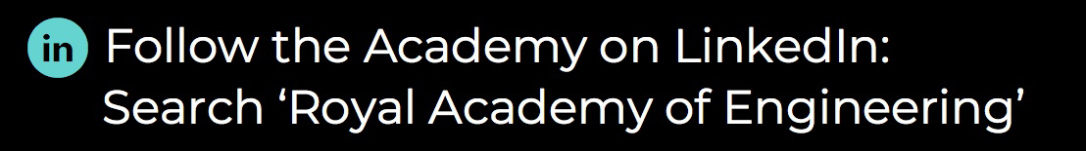

About us
The Royal Academy of Engineering is harnessing the power of engineering to build a sustainable society and an inclusive economy that works for everyone.
In collaboration with our Fellows and partners, we’re growing talent and developing skills for the future, driving innovation and building global partnerships, and influencing policy and engaging the public.
Together we’re working to tackle the greatest challenges of our age.
Get in touch at:

