Slide 1
Creating Inclusive Cultures
Problem-solving
Team workshop series
@RAEngNews | www.raeng.org.uk/teamworkshops

Slide 2
Agenda
Welcome, introductions and health and safety message
Ashby's Law and the relevance to engineering
Quiz
Problem-solving riddle
Developing an objective
Thank you and feedback

Slide 3
Ashby’s Law of Requisite Variety
W Ross Ashby (6 September 1903 – 15 November 1972) was an English psychiatrist and a pioneer in cybernetics.
What is Ashby’s Law?
“If a system is to be able to deal successfully with the diversity of challenges that its environment produces, then it needs to have a repertoire of responses which is (at least) as nuanced as the problems thrown up by the environment. So a viable system is one that can handle the variability of its environment.”
Or, as Ashby put it: “only variety can absorb variety.”

Slide 4
Why is Ashby’s Law relevant?
Consider:
Innovation to meet diverse demands through diversity of thought.
People from differing backgrounds, upbringing and experience – new perspectives.
Interacting with individuals who share similar values, opinions, and interests –perceived to be rewarding because doing so reinforces own values, opinions and interests.

Slide 5
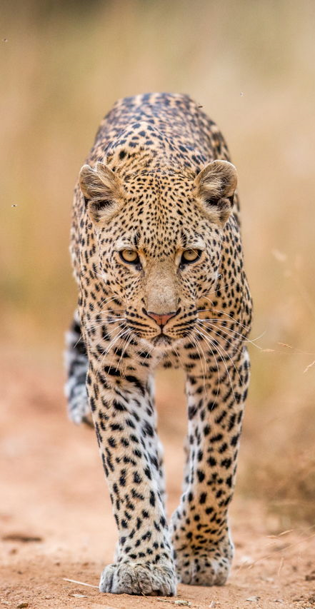
What does Ashby’s Law mean in nature?
The leopard
Problem in environment:
Response:
Extreme temperature range.
Excellent night vision allows hunting to be done mainly at night when it is cooler.
Fur for warmth in cool overnight temperatures.
Strong competition with other predators such as lions.
Lightweight and excellent climbing ability compared to other predators, the leopard often stores and eats its prey in trees.
Dry environment.
May eat water-rich plants to supplement water intake.
Fast prey.
Camouflage fur pattern to enable stalking of prey.

Slide 6
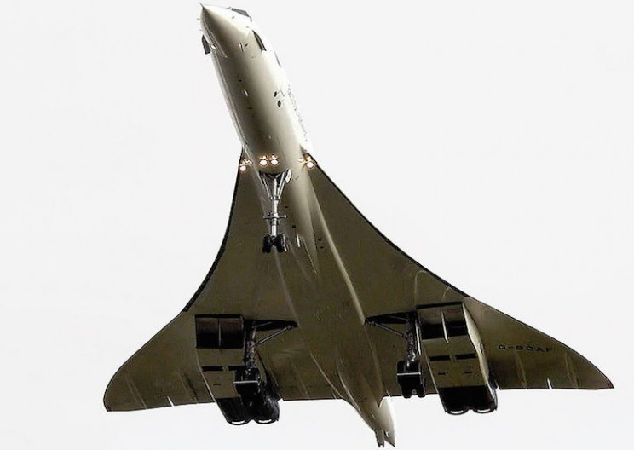
What does Ashby’s Law mean in engineering?
Concorde: High-speed but expensive flight across the Atlantic
Wikimedia Commons
Variability in the environment:
Rising fuel prices.
Environmental and noise concerns..
Response to the problem:
No response – Concorde ended service in 2003.
More fuel efficient, quieter engines = expensive and difficult to integrate.
Variation in the market outnumbered the responses the product could offer.

Slide 7

What does Ashby’s Law mean in business?
Silicon Valley vs Boston’s Route 128 companies
Variability in the environment:
Boston – Large, secure, secrecy-focused, isolated conglomerates
Silicon Valley – clusters of small start ups, promoting engagement and cross-fertilisation of ideas.
Rise of personal computers and workstations.
Overseas competition.
Response to the problem:
Boston – increased protection and secrecy.
Silicon Valley – promotion of openness and flexibility.
Silicon Valley thrived through the sharing of ideas and approaches.

Slide 8
Quiz!

Slide 9
Q1
Police officers’ stab-proof vests are designed to fit both male and female body shapes.
True or false?

Slide 10
Q2
Men and women have the same degree of tolerance to exposure to drugs and toxins.
True or false?

Slide 11
Q3
The standard house brick was designed to be laid by anyone, male or female.
True or false?

Slide 12
Q4
In research, Google’s speech recognition software was found to be 40% more likely to accurately recognise male speech than female speech.
True or false?

Slide 13
Q5
A video went viral of a soap dispenser that only recognised white hands.
True or false?

Slide 14
Q6
Companies with more ethnic diversity on their executive teams are more profitable.
True or false?

Slide 15
Q7
What is the annual disposable income of the Black, Asian and minority ethnic community in the UK?
£50 million
£1.76 billion
£300 billion

Slide 16
Q8
How many people in the UK are currently diagnosed with arthritis?
0.5 million
2 million
10 million

Slide 17
Q9
The remote control, cruise control and bendy straws were all innovations designed for, with, and by the disabled community.
True or false?

Slide 18
Q10
EU regulatory crash-test requirements include the assessment of car seat belts using ‘pregnant’ women-shaped crash test dummies.
True or false?

Slide 19
End of quiz

Slide 20
Answers

Slide 21
Q1
Police officers’ stab proof vests are designed to fit both male and female body shapes.
False
They are a one shape fits all design. Because no account is taken of breast size these can leave female officers vulnerable because of incorrect fitting. British female police officers report being bruised by their kit belts. A number have had to have physiotherapy because of the way stab vests sit on their body. Many complain that there is no space for their breasts, which is not only uncomfortable but also results in stab vests coming up too short, leaving women unprotected.

Slide 22
Q2
Men and women have the same degree of tolerance to exposure to drugs and toxins.
False
Women tend to have thinner levels of skin but testing of safe levels of exposure to drugs is carried out according to a standardised and male-orientated benchmark.
Dosages of drugs are designed in the same standardised, male-focused way, with potentially differing levels of active elements entering the body dependent on someone’s sex.

Slide 23
Q3
The standard house brick was designed to be laid by anyone, male or female.
False
It was designed to be handled by men, fitting their ‘standard’ hand size more readily.
Today, many mobile phone companies have been criticised for making their phones larger than the average female hand, potentially alienating a large number of consumers.

Slide 24
Q4
In research, Google’s speech recognition software was found to be 40% more likely to accurately recognise male speech than female speech.
False
The actual figure was 70% more likely. One woman reported that her car’s voice-command system only listened to her husband, even though he was in the passenger seat.
Research has also found that speech recognition systems make far fewer errors with white users than with black users.

Slide 25
Q5
A video went viral of a soap dispenser that only recognised white hands.
True
A senior black worker at Facebook posted a video of this, which has been shared over 200,000 times.
He highlighted a) that the light sensor in the dispenser was likely not tested on a variety of skin tones excluding users worldwide b) the importance of diversity in tech and its impact on society.

Slide 26
Q6
Companies with more ethnic diversity on their executive teams are more profitable.
True
The latest research by McKinsey (Diversity Wins) shows that companies in the top quartile for ethnic diversity on executive teams are 36% more profitable than companies in the bottom quartile.
The likelihood of outperformance is higher for diversity in ethnicity than for gender, with companies in the top quartile for gender diversity on executive teams outperforming companies at the bottom by 25%.

Slide 27
Q7
What is the annual disposable income of the Black, Asian and minority ethnic community in the UK?
d) £300 billion
Consider products that bear the colour name ‘nude’ in the UK and whether this would meet the skin tone requirements of BAME people in relation to, for example, cosmetics, clothing, shoes – does this present an open market opportunity?

Slide 28
Q8
How many people in the UK are diagnosed with arthritis?
c) 10 million
Leading arthritis charity Arthritis Care says there are around 10 million people of all ages in the UK affected by arthritis.
Consider how meeting this group’s needs might impact on the design and manufacture of, for example, cooking utensils.

Slide 29
Q9
The remote control, cruise control and bendy straws were all innovations designed for, with, and by the disabled community.
True
Remote controls were originally designed for people with limited mobility.
Cruise control was designed by Ralph Teetor, a blind engineer.
Bendy Straw was invented by Joseph Friedman because his daughter was too short to reach her milkshake with a straight straw.

Slide 30
Q10
EU regulatory crash-test requirements include the assessment of car seat belts involving ‘pregnant’ women-shaped crash test dummies.
False
There is only one EU seat test that references a ‘female’ dummy (and is only a scaled-down version of the male dummy) but the standard ‘female shape’ is only tested in the passenger seat.
Pregnant crash-test dummy testing is not mandated in the US or the EU.

Slide 31
Problem-solving
Let’s look at a problem…

Slide 32
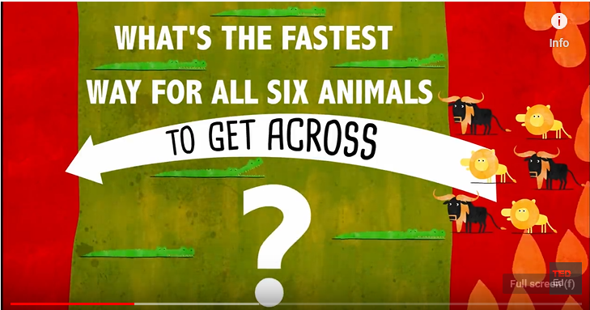
Watch the river crossing riddle

Slide 33
Discussion
What do you think this riddle can tell us about diversity and inclusion in the workplace?

Slide 34
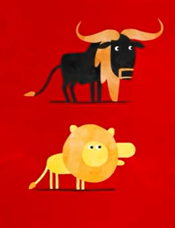
Diverse (and inclusive) teams
Diverse people have different needs and perspectives.
Diversity can bring different qualities, skills and ideas to the team which is great for business!
It may take time for a more diverse team to figure out its team dynamics – communication is key.
Diverse teams, even unlikely pairings, operating with an inclusive culture, can work together successfully and may deliver more innovative solutions thanks to their diversity.

Slide 35
Developing an objective
In small groups or pairs:
Can you think of areas in your business where there may be missed opportunities because there is insufficient diversity in your team or company?
For example – with ways of working you've seen in another industry
For example – with products, outputs or innovation
For example – with customer relationships
For example – Could we enhance / adapt what we do to reach a wider audience?
Agree an individual or team objective to enhance an area of business through increased diversity and inclusion.
Discuss how we are going to achieve this/these objective/s and what support might be required.

Slide 36
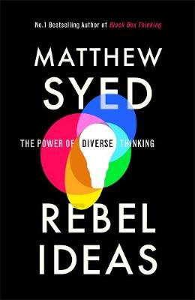
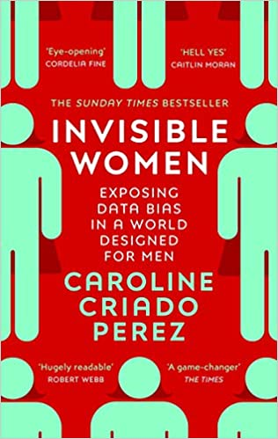
Extra reading
If you found the quiz interesting read the source articles in your own time after the training:
Invisible Women: Exposing Data Bias in a World Designed for Men by Caroline Criado Perez
Rebel ideas: The Power of Diverse Thinking by Matthew Syed
Creative Diversity, The state of diversity in the UK’s creative industries, and what we can do about it by Creative Industries Federation

Slide 37
Thank you and feedback
Thank you for attending this workshop
Please fill in the brief online feedback survey for the Academy so that we may continue to learn and improve the sessions we run.

Slide 38
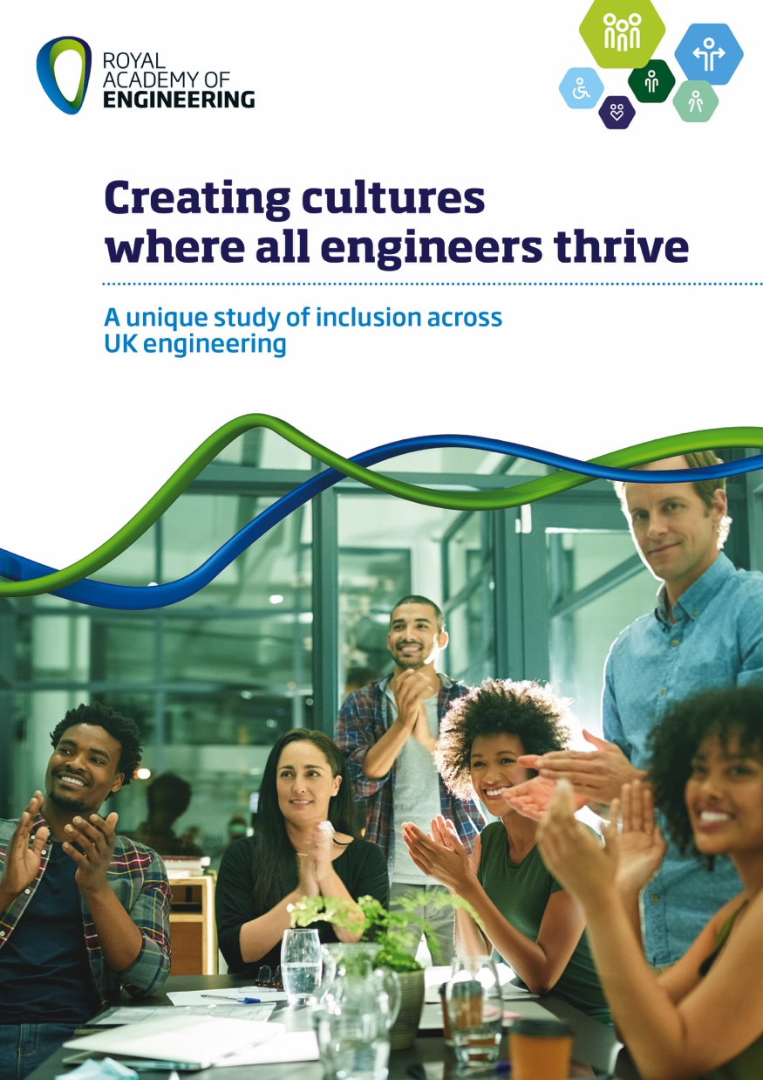
Want to know more?
Four workshops:
Why is diversity and inclusion important?
Language and banter
Ways of working
Problem-solving
www.raeng.org.uk/teamworkshops

Slide 39


About us
The Royal Academy of Engineering is harnessing the power of engineering to build a sustainable society and an inclusive economy that works for everyone.
In collaboration with our Fellows and partners, we’re growing talent and developing skills for the future, driving innovation and building global partnerships, and influencing policy and engaging the public.
Together we’re working to tackle the greatest challenges of our age.
Get in touch at:

